Slide 1


AIRLINE RESERVATION SYSTEM
SUPERVISOR Mr.A.Malarmannan,M.E., AP/CSE.
PRESENTED BY
2303811710421145 – SHEEBA S

Slide 2

PRESENTATION OVERVIEW
Objective
Project Introduction
Problem Statement
Methodologies (Programming concepts relevant to problem statement)
Architecture of the proposed system
List of Modules
7. Merits
8. Results and Discussion
9. Queries

Slide 3
OBJECTIVE
To create a user-friendly and interactive flight reservation system where users can search, book, and manage their flight reservations through a graphical interface. This system will provide users with an easy way to interact with flight information and manage their reservations efficiently.
Users can view available flights and book a seat if there are available seats on the selected flight. The system ensures that once a flight is booked, the available seats for that flight are decremented.
After booking a flight, users can view their reservations. They can also cancel an existing reservation, which updates the available seats for the corresponding flight.
When a user books a flight, decrement the available seats for the flight. When a user cancels a reservation, increment the available seats for the corresponding flight.

Slide 4
PROJECT INTRODUCTION
The Airline Reservation System program is designed to simulate a basic flight booking and reservation management system using Java’s Swing GUI components.
This system allows users to search for available flights, book flights, and manage their reservations in a straightforward and interactive way.
After selecting a flight from the list, the user can book the flight if there are available seats. When a flight is booked, the number of available seats decreases by one, reflecting the new seat count.
The program uses a graphical user interface built with Java Swing components such as JFrame, JPanel, JTextField, JTextArea, and JButton. The interface is intuitive, with dedicated panels for flight search, available flights, and user reservations.

Slide 5
PROBLEM STATEMENT
The Airline Reservation System program aims to create a simple desktop application that allows users to search for available flights, book flights, and manage their reservations. The system should be able to handle flight data, allow users to perform essential operations like booking and canceling flights, and display real-time updates for available seats.
The problem can be broken down into the following requirements:
Flight Management
Search Functionality
Flight Booking
Reservation Management
User Interface

Slide 6
Methodologies (Programming concepts relevant to problem statement)
Encapsulation: • The Flight class encapsulates flight details like flight number, route, and available seats.
Inheritance and Polymorphism: • Extendable design, though not explicitly implemented, can be applied for additional features like customer profiles.
Abstraction: • The system abstracts operations like search, booking, and cancellation into intuitive methods.

Slide 7
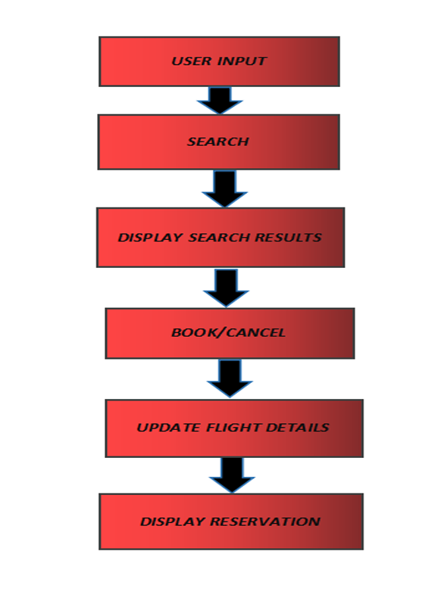
Architecture of the proposed system

Slide 8
MODULE DESCRIPTION
Booking Module : allows users to book multiple seats at once, giving flexibility for group or family bookings. It includes features like input validation to ensure that enough seats are available before confirming the reservation.
Reservation Management Module: It enables users to view, modify, or cancel multiple reservations efficiently. It may incorporate checkboxes or lists with actions for each reservation, providing a more user-friendly way to manage bookings.
Flight Booking Confirmation Module: Before finalizing a reservation, this module presents a review page that summarizes the flight details, number of seats, and final price. It ensures users can double-check their booking details and confirm before submitting.
Flight Information Module: Enhances the displayed flight details by including additional information like airline names, pricing, and available amenities, helping users make more informed decisions when selecting a flight

Slide 9
MERITS
Well-Organized Code: The code is split into separate parts (Flight and ReservationSystem), making it easier to understand, maintain, and extend.
Scalability: It's easy to add more features to the system, like payment options or a user login system, without disrupting the existing features.
Easy to Extend: The system is flexible, so more flight details (like price, flight duration, etc.) can be added easily.

Slide 10
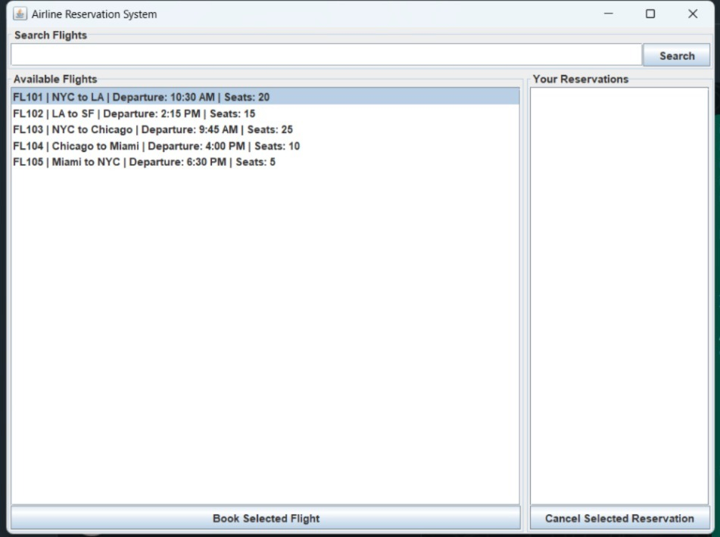
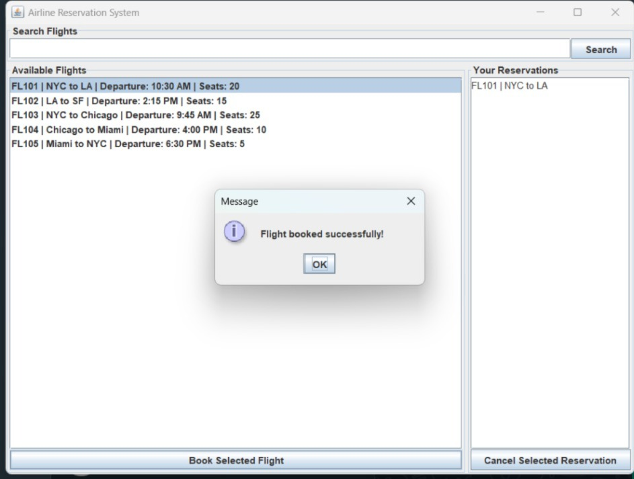
RESULT AND DISCUSSION

Slide 11
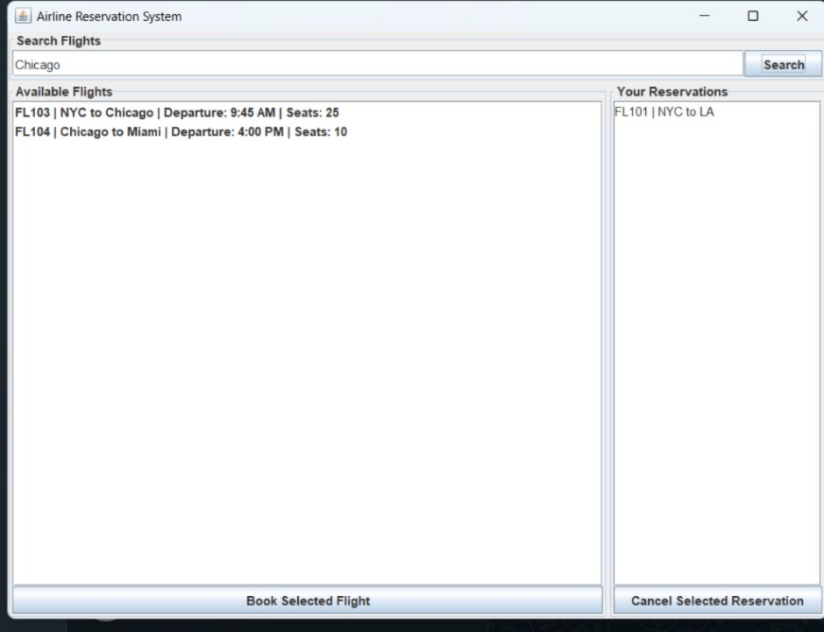
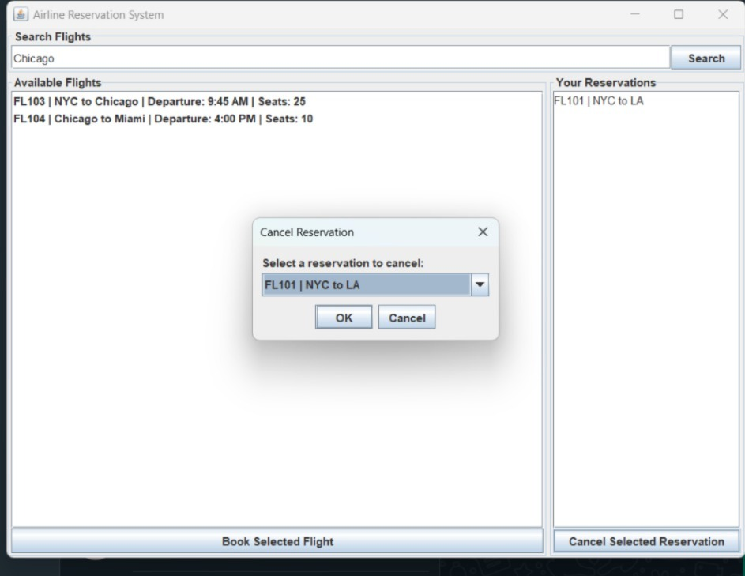
RESULT AND DISCUSSION

Slide 12
ANY QUERIES ?

Slide 13
THANK YOU

